Slide 1


DEPARTMENT OF INFORMATION TECHNOLOGY
Project name : Smart Parking
Team name : Proj_224789_Team_4
Team members :
Mohamed Nayeemullah S (113321205030)
Thariq Hameed A (113321205052)
Mohamed Sheik Noor A (113321205031)
Adhithyan K S (113321205002)

Slide 2
Procedure
Step 1: Define Project Requirements and Objectives
1.1. Clearly define the goals and objectives of your Smart Parking IoT project.
1.2. Identify the specific parking facility or area where you'll deploy the system.
1.3. Determine the budget, hardware, and software requirements for your project.
Step 2: Sensor Selection and Installation
2.1. Choose appropriate parking space sensors (e.g., ultrasonic or infrared) based on your project's requirements and budget.
2.2. Install the selected sensors in each parking space. Ensure they are securely mounted and calibrated for accurate occupancy detection.
Step 3: Microcontroller Setup
3.1. Select a microcontroller platform for data collection and processing (e.g., Arduino, Raspberry Pi).
3.2. Connect the sensors to the microcontroller, and write code to collect data from the sensors and determine parking space occupancy status (vacant/occupied).
Step 4: Connectivity and Data Transmission
4.1. Choose a communication method for data transmission (e.g., Wi-Fi, Bluetooth, LoRa, cellular).
4.2. Establish reliable connectivity between the microcontroller and a central server or cloud platform.
4.3. Develop code to transmit parking data to the central server in real-time.
Step 5: Central Server Setup
5.1. Set up a central server (cloud-based or on-premises) to receive and store parking data.
5.2. Create a database to manage parking space information, user accounts, and historical data.

Slide 3
Step 6: User Interface Development
6.1. Develop a user-friendly mobile or web application to provide real-time parking information to users.
6.2. Design the application interface, including features for checking parking availability, making reservations, and processing payments.
Step 7: Real-Time Updates
7.1. Implement a real-time update mechanism within the application so that users can see immediate changes in parking availability as spaces are occupied or vacated.
Step 8: Payment Integration
8.1. Integrate secure payment gateways to allow users to pay for parking services through the application.
8.2. Test payment functionality to ensure it processes payments accurately and securely.
Step 9: Security Measures
9.1. Implement robust security measures to protect user data, payment information, and the system infrastructure from cyber threats.
9.2. Use encryption and secure authentication mechanisms.
Step 10: User Alerts
10.1. Develop a notification system to alert users about parking availability, confirm reservations, and provide reminders.

Slide 4
Step 11: Data Analytics and Insights
11.1. Utilize collected data for analytics to identify parking patterns, peak hours, and other insights.
11.2. Develop data visualization tools to present analytics to administrators and users.
Step 12: Scalability
12.1. Design the system to be scalable, allowing for easy expansion to cover additional parking areas or facilities as needed.
Step 13: Testing and Quality Assurance
13.1. Conduct thorough testing at each stage of development to ensure system functionality, security, and reliability.
13.2. Perform load testing to assess the system's performance under high user traffic.
Step 14: Documentation and User Education
14.1. Maintain clear and comprehensive documentation of the system, including hardware components, software architecture, code explanations, and user guides.
14.2. Provide user education materials and resources to help drivers adapt to the new parking system and understand how to use the application effectively.

Slide 5
Step 15: Regulatory Compliance
15.1. Ensure compliance with local regulations and standards related to data privacy, payment processing, and IoT device deployment.
Step 16: Deployment
16.1. Deploy the Smart Parking IoT system in the target location, ensuring proper sensor calibration and system readiness.
16.2. Conduct a pilot deployment and gather user feedback to identify and address any issues.
Step 17: Maintenance and Support
17.1. Establish a maintenance plan to ensure the system's continued efficiency and reliability.
17.2. Provide customer support for users who may encounter issues or require assistance.
By following these steps, you can build a functional and efficient Smart Parking IoT system that enhances parking space management and improves the overall urban mobility experience.

Slide 6
Components
1. Sensors: Ultrasonic Sensors: for detecting the presence of vehicles in parking spaces.
Infrared (IR) Sensors: an alternative to ultrasonic sensors for occupancy detection.
Magnetic Sensors: for detecting the presence of vehicles through changes in the magnetic field.
Image Sensors or Cameras: for capturing images of parking spaces and vehicles (optional for advanced systems).
2. Microcontroller/Single-Board Computer: Arduino: for data collection, processing, and control.
Raspberry Pi: for more advanced applications or when requiring computer vision capabilities.
3. Connectivity: Wi-Fi Module: for connecting the microcontroller to the internet.
Cellular Module (3G/4G/5G): for remote or areas with limited Wi-Fi coverage.
Bluetooth Module: for short-range communication with mobile devices (optional).
4. Power Supply: Power Adapter or Battery: to supply power to the sensors and microcontroller.
5. Central Server: Cloud Server or On-Premises Server: for receiving, storing, and processing parking data.
6. Database: SQL or NoSQL Database: for managing parking space information, user data, and historical records.
7. User Interface: Mobile App: for users to check parking availability, make reservations, and receive notifications.
Web Application: for users to access the system via web browsers.

Slide 7
Components
8. Real-Time Updates: WebSocket or Server-Sent Events (SSE): for providing real-time parking availability updates to users.
9. Payment Integration: Payment Gateway: for processing parking payments securely within the app.
10. Security Measures: Encryption: to secure data transmission.
Authentication Mechanisms: for user login and access control.
Secure Socket Layer (SSL) Certificates: for secure web communication.
Firewalls and Intrusion Detection Systems (IDS): for protecting the system from cyber threats.
11. User Alerts: Push Notification Service: for sending alerts and notifications to users.
12. Display: to show the number of parking slot occupied or free.

Slide 8
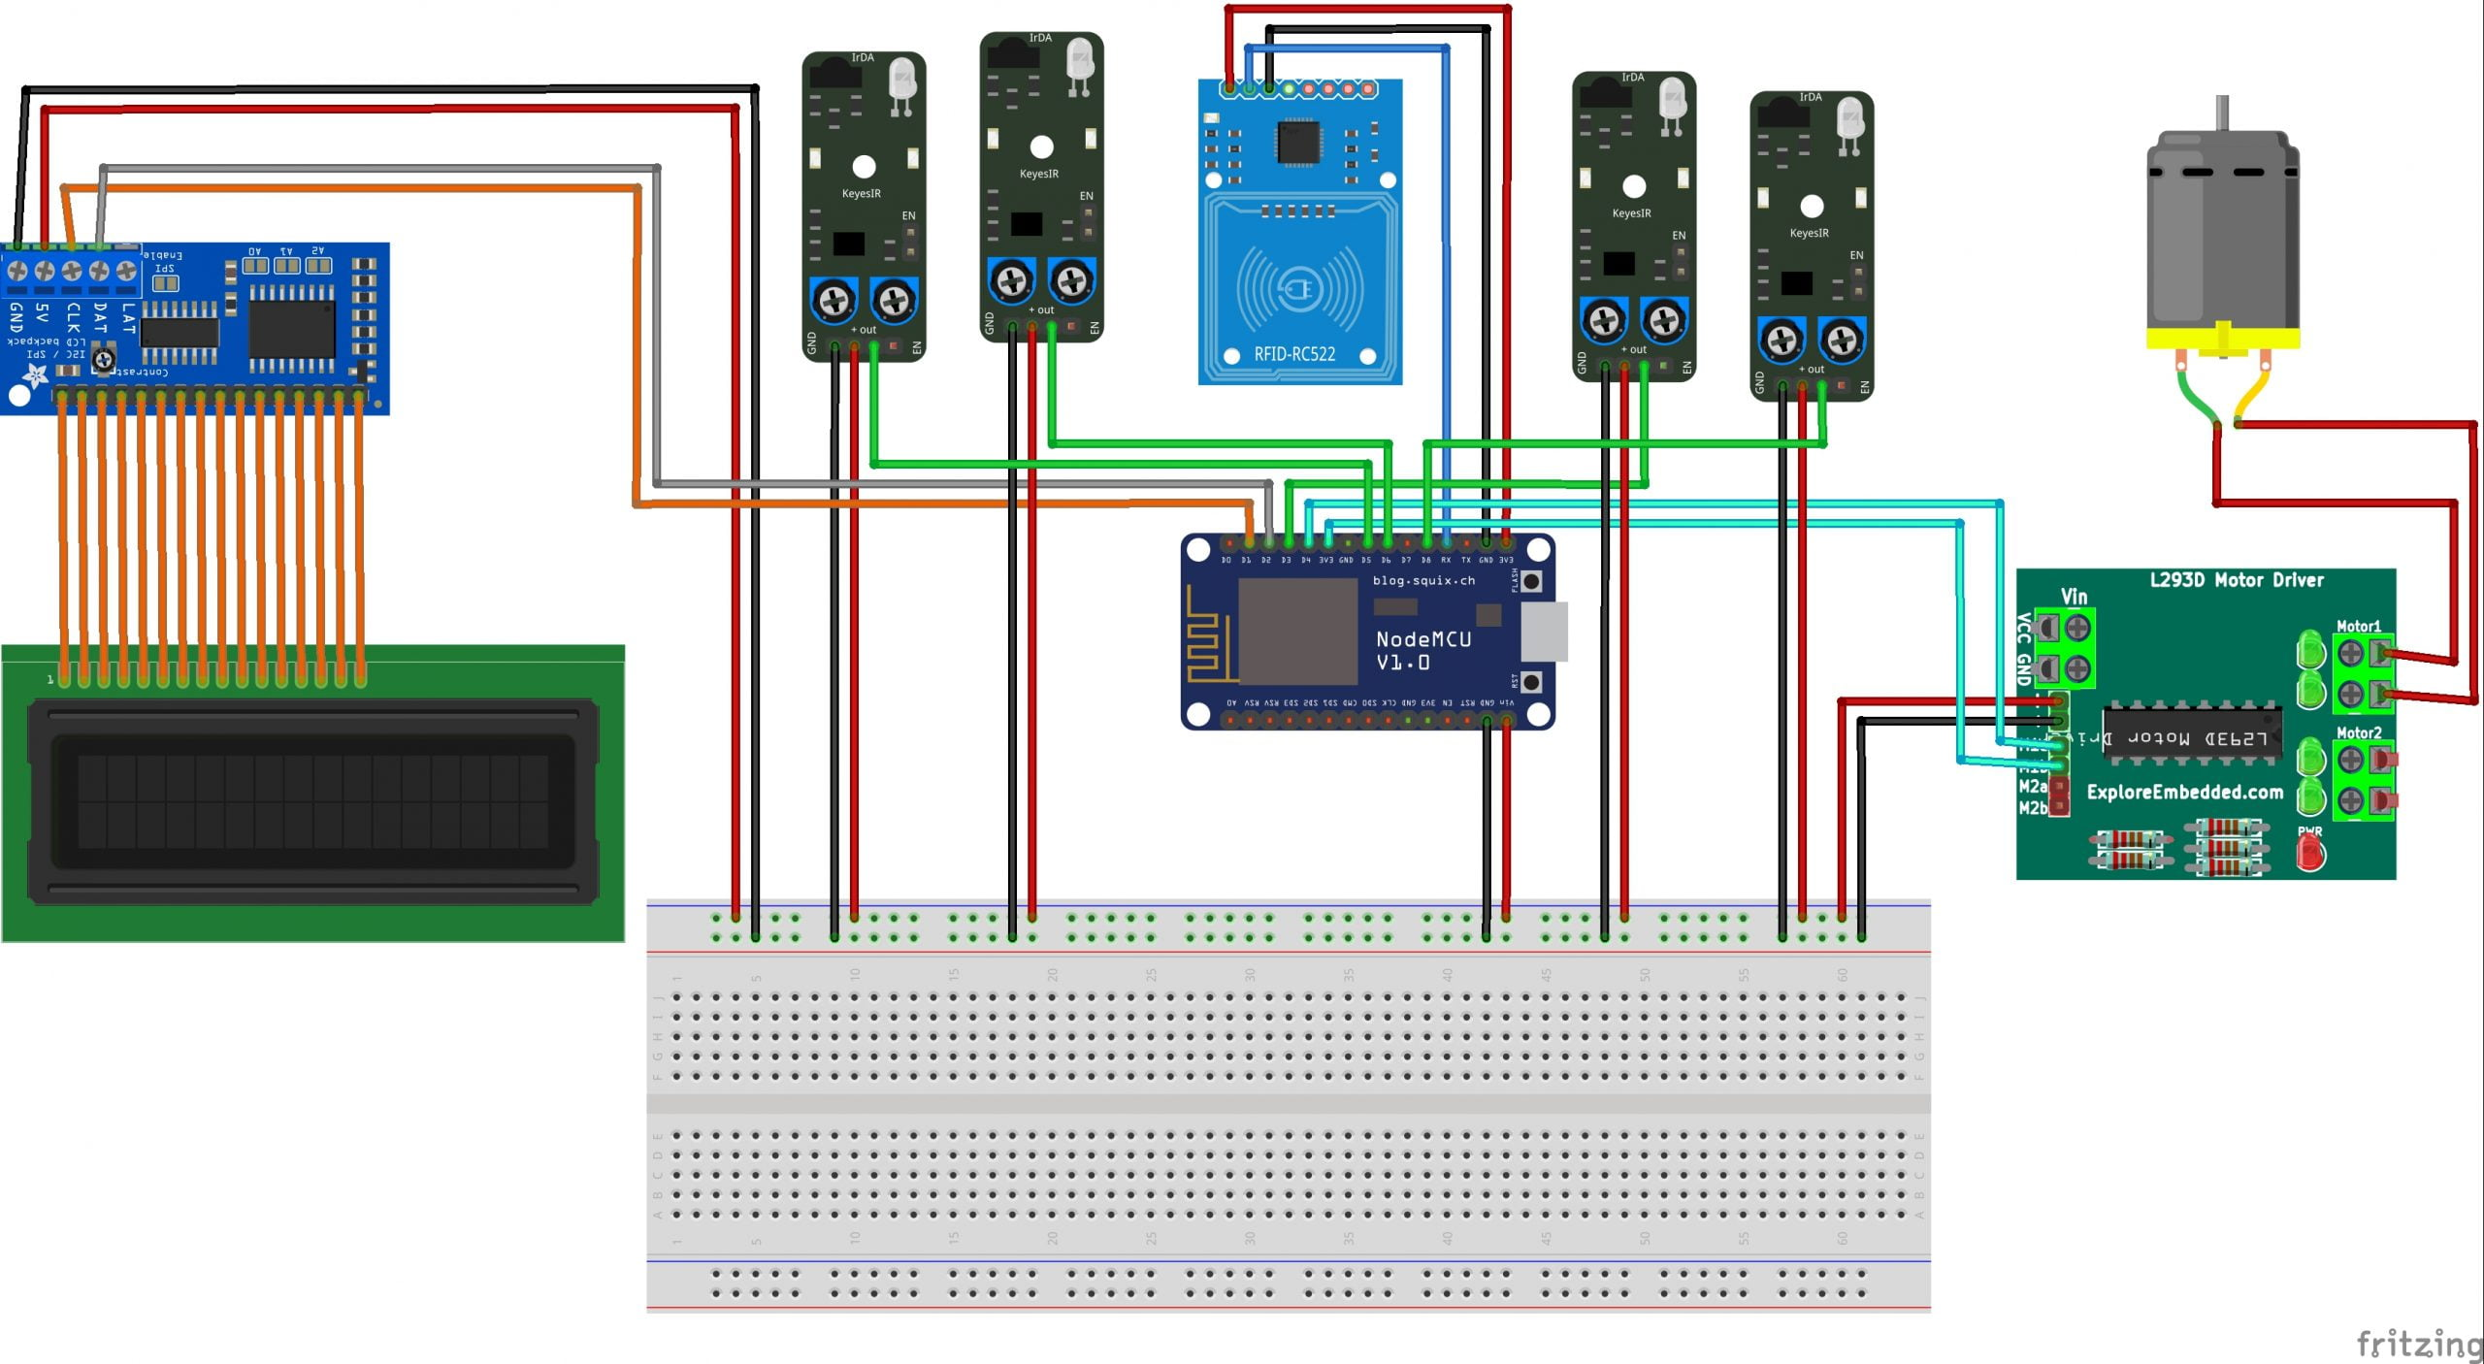
Model

Slide 9
THANK YOU

